Slide 1
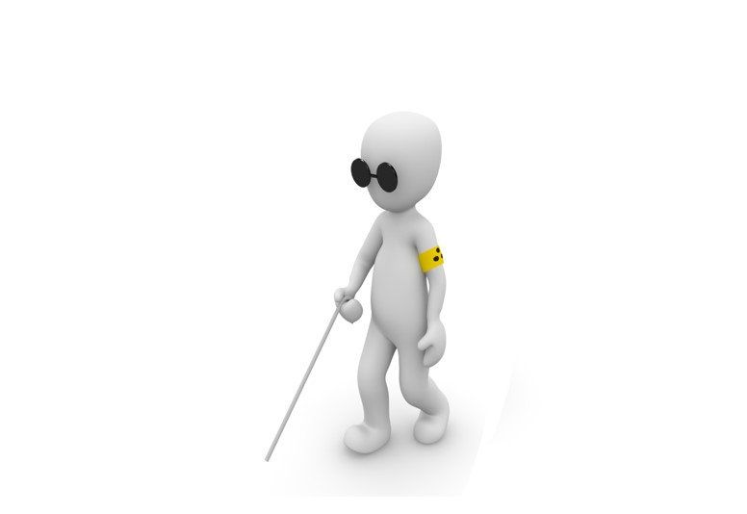
THIRD EYE OF THE BLIND
Project Guide
Sr Asst Prof. K Shyamala M Tech ( PhD )
Team Members
Purnima Reddi ( 19Q71AO490 )
Kiran Kumar Patro ( 19Q71AO478 )
Bhuvan Varshit Tamarana ( 19Q71AO498 )
Rahul Kottapalli ( 19Q71AO487 )

Slide 2
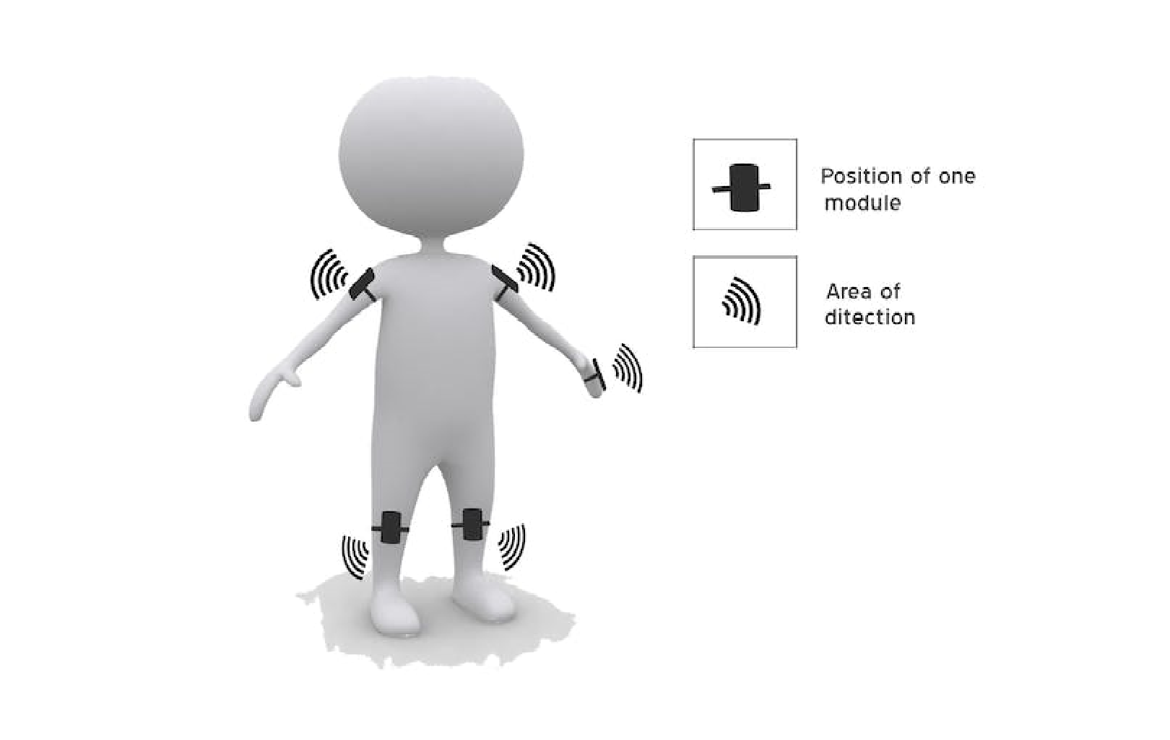
Abstract
The third eye for blinds is an innovation that helps blind people to navigate with speed and confidence by detecting the nearby obstacles using the help of ultrasonic waves and notifying them with a buzzer sound or vibration. They only need to wear this device as a band or cloth. It is the first wearable technology for blind people which resolves all the problems of existing technologies. Nowadays there are many instruments and smart-devices for visually impaired people for navigation.
So the aim of the project is to develop a cheap and more efficient way to help visually impaired to navigate with greater comfort, speed and confidence.

Slide 3
Existing System & Limitations
White cane - May easily crack/break, The stick may get stuck at pavement cracks of different objects.
Pet dog - Huge cost around 280000Rs & well trained
Common Disadvantages (Including the smart devices) Cannot be carried easily, needs a lot of training to use…

Slide 4
Proposed System
This device will help the blind to navigate without holding a stick which is a bit annoying for them. They can simply wear it as a band or cloth and it can function very accurately and they only need a very little training to use it.
we have designed a special wearable device based on the arduino board which can be worn like a cloth for blinds. This device is equipped with five ultrasonic sensors, consisting of five modules which are connected to the different parts of the body.
Blind can detect the objects in a view around them and can easily travel anywhere. When the ultrasonic sensor detects obstacle the device will notify the user through vibrations or sound beeps. The intensity of vibration and rate of beeping increases with decrease in distance and this is a fully automated device.

Slide 5
Equipment Required
Hardware Requirements:
Ardunio Nano
Ultra sonic sensor
Buzzer module
Vibration motor
Slide Switch
Power Supply
Software Requirements:
Arduino web editor

Slide 6
System Design
Arduino
Nano
Power supply
Buzzer
Ultrasonic Sensor

Slide 7
System Design
Arduino
Nano
Power supply
LED
Buzzer
Ultrasonic Sensor
Vibration motor

Slide 8

Ultra Sonic Sensing
Obstacle
2cm – 45cm
Ultra Sonic Sensor

Slide 9
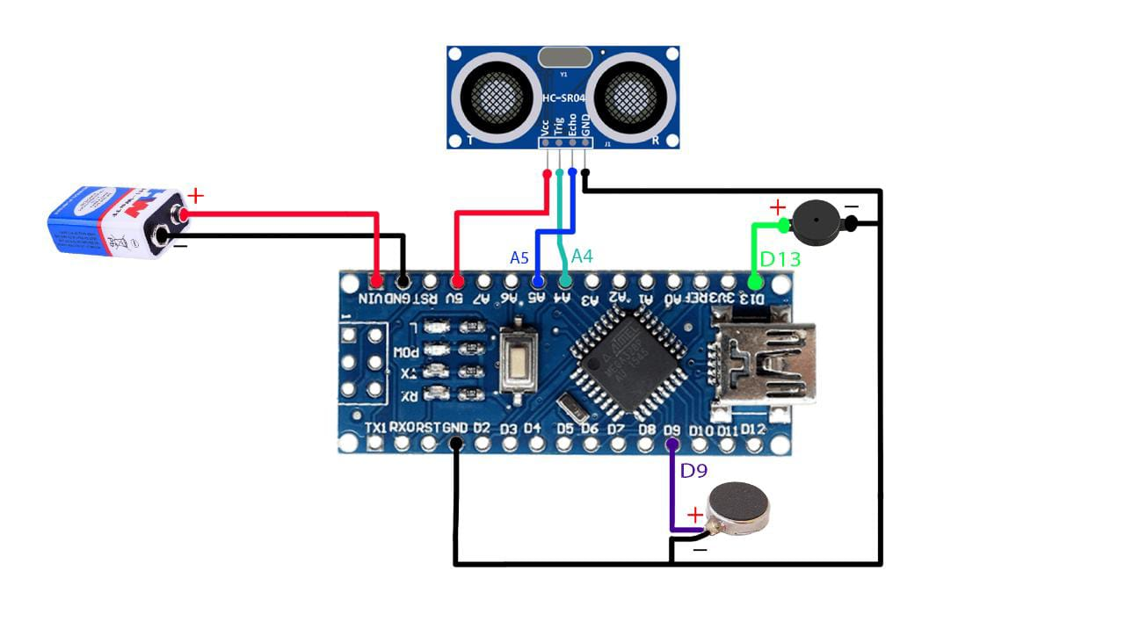
Circuit Diagram

Slide 10
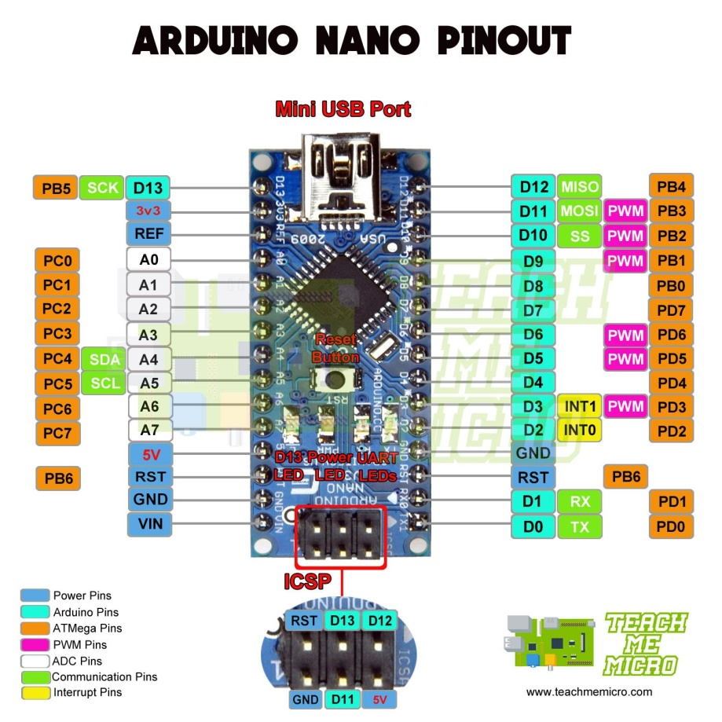
Component’s
Arduino Nano
Arduino Nano is a small, breadboard-friendly development board based on an ATmega328P SMD package microcontroller and offers the same connectivity and specs of Arduino Uno in a small package. DC Power Jack is not available on this board so power can only be supplied by a Mini B USB port present on it or 6-20V unregulated external power supply from Pin 30 (Vin). Due to its small size its very popular among IoT based projects which need to be small and user friendly, in Robotics, in Automation, Instrumentation and Control systems

Slide 11
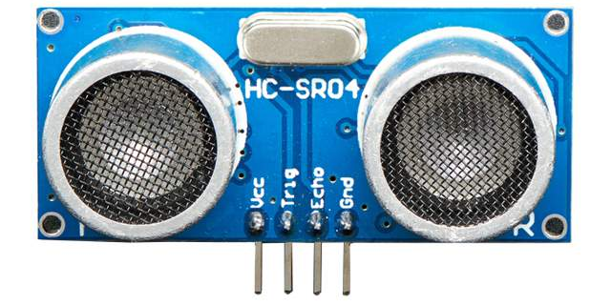
Component’s
Ultrasonic sensor
An ultrasonic sensor is an instrument that measures the distance to an object using ultrasonic sound waves.
GND – Ground pin
VCC – Voltage pin
Trig – Input sound value
echo – Output sound wave

Slide 12
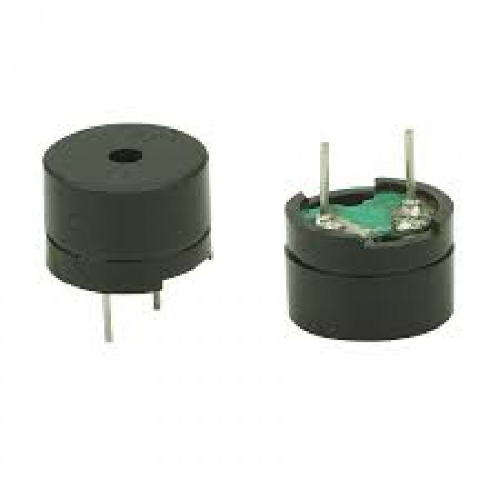
Component’s
Buzzer
-ve to Ardunio GND and +ve to digital pin 5
Sample code
int buz=5;
digitalWrite(buz, LOW);
digitalWrite(buz, HIGH);

Slide 13
Application’s
It works as a navigation device for blind people.
This system can be used to navigate by everyone not only visually impaired under certain circumstances like foggy mornings with low visibility.
This system can also be used by patients suffering with various eye ailments like cataract ,exophthalmia post eye operative situations and others.
This system can be modified into a more sophisticated version of itself by using high intensity ultrasonic waves to be used as a navigation for geological explorations.

Slide 14
Conclusion
Thus, this project proposed the design and architecture of a new concept of Arduino based Virtual Eye for the blind people. A simple, cheap, efficient, easy to carry, configurable, easy to handle electronic guidance system with many more amazing properties and advantages is proposed to provide constructive assistant and support for the blind and visually impaired persons.
The system will be efficient and unique in its capability in specifying the source and distance of the objects that may encounter the blind. It is able to scan and detect the obstacles in the areas like left, right, and in front of the blind person regardless of its height or depth. With the proposed architecture, if constructed with at most accuracy, the blind will be able to move from one place to another without others help.

Slide 15
THANK YOU

